Slide 1
Chapter 1
Introduction

Slide 2
DATA COMMUNICATIONS
The term tele(far)communication means communication at a distance. The word data refers to information presented in whatever form is agreed upon by the parties creating and using the data. Data communications are the exchange of data between two devices via some form of transmission medium such as a wire cable.
Topics discussed in this section:
Components of a data communications system
Data Flow

Slide 3
DATA COMMUNICATIONS
The effectiveness of data communication depends on four fundamental characteristics:
-- delivery
System must deliver data to the correct destination
Data must be received by the intended device or user.
-- accuracy
The system must deliver the data accurately.
Data that have been altered in transmission and left uncorrected are unusable.
-- timeliness
The system must deliver data in a timely manner. Data delivered late are useless.
In the case of video and audio data, timely delivery means – the data should be receive without any significant delay.
-- jitter
Variation in the packet arrival time. It is the uneven delay in the delivery of audio or video packets. For example, let us assume that video packets are sent every 30ms. If some of the packets arrive with 30ms delay and others with 40ms delay, an uneven quality in the video is the result.

Slide 4
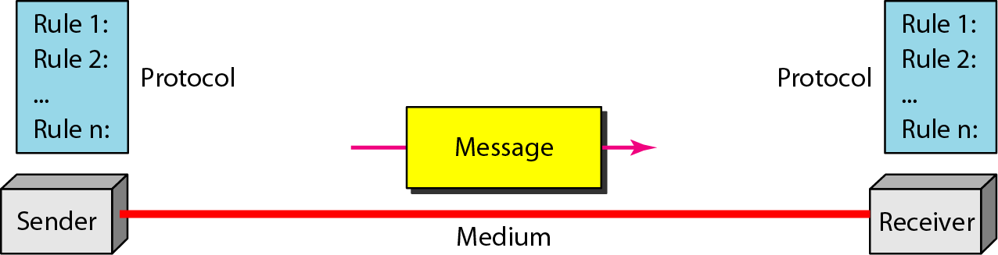
Figure 1.1 Components of a data communication system
Message: The message is the information (data) to be communicated. Popular forms of information include text, numbers, pictures, audio, and video.
Sender/Receiver: The sender is the device that sends the data. The receiver is the device which receives the data. Sender and Receiver could be computers, workstation, telephone handset, television, and so on.
Medium: The transmission medium is the physical path by which a message travels from sender to receiver. Some examples of transmission media include twisted-pair wire, coaxial cable, fiber-optic cable, and radio waves.
Protocol: A protocol is a set of rules that govern data communications. It represents an agreement between the communicating devices.

Slide 5
DATA REPRESENTATIONS
Text
Numbers
Images
Audio
Video

Slide 6
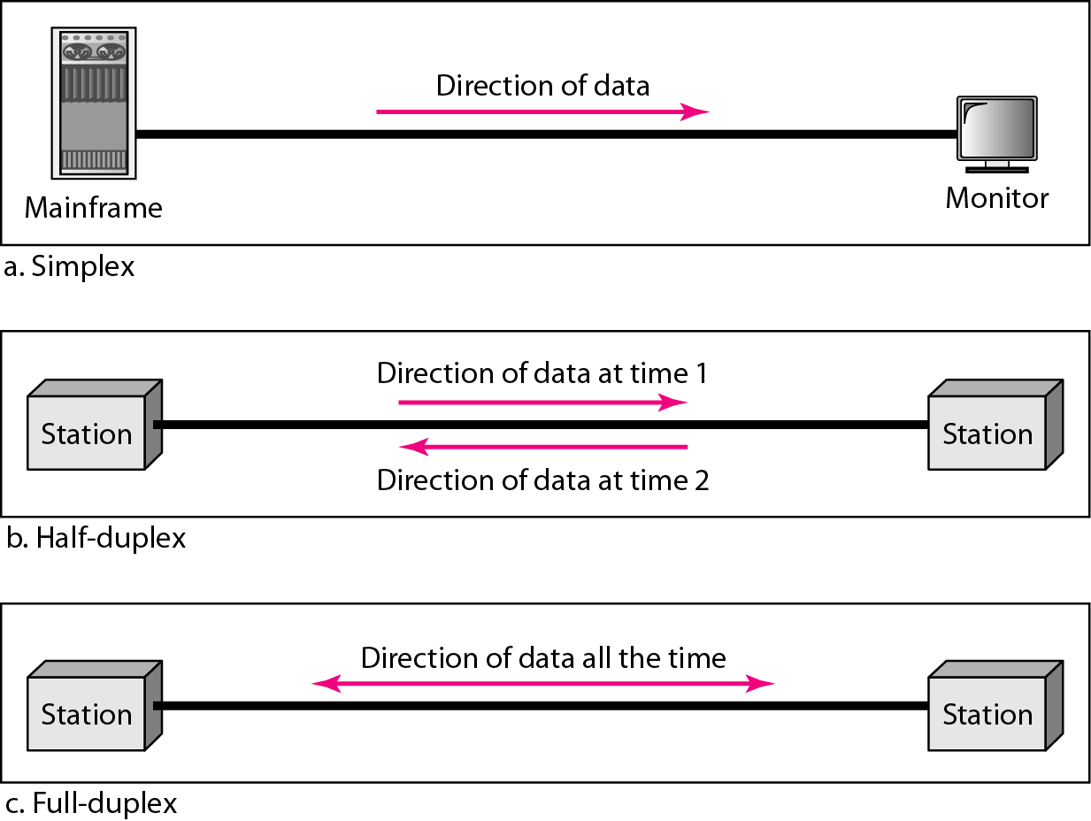
Figure 1.2 Data flow (simplex, half-duplex, and full-duplex)
In simplex mode, the communication is unidirectional, as on a one-way street.
Only one of the two devices on a link can transmit; the other can only receive
Ex:- Keyboards and traditional monitors
Each station can both transmit and receive, but not at the same time. When one device is sending, the other can only receive, and vice versa. The half-duplex mode is like a one-lane road with traffic allowed in both directions.
In a half-duplex transmission, the entire capacity of a channel is taken over by whichever of the two devices is transmitting at the time.
Ex:- Walkie-talkies

Slide 7
Full duplex mode: Both stations can transmit and receive simultaneously
The full-duplex mode is like a two-way street with traffic flowing in both directions at the same time.
In full-duplex mode, signals going in one direction share the capacity of the link: with signals going in the other direction.
Ex: telephone network

Slide 8
NETWORKS
A network is a set of devices (often referred to as nodes) connected by communication links. A node can be a computer, printer, or any other device capable of sending and/or receiving data generated by other nodes on the network. A link can be a cable, air, optical fiber, or any medium which can transport a signal carrying information.
Topics discussed in this section:
Network Criteria
Physical Structures
Categories of Networks

Slide 9
Network Criteria
Performance
Measured in terms of Delay and Throughput
Measured in accordance with transit and response time
Performance of network is dependent on
Number of users,
Types of transmission medium used,
Capabilities of connected hardware,
Efficiency of software.
Reliability
Failure rate of network components
Measured in terms of availability/robustness
Security
Data protection against corruption/loss of data due to:
Errors
Malicious users

Slide 10
Physical Structures
Type of Connection
Point to Point - single transmitter and receiver
Multipoint - multiple recipients of single transmission
Physical Topology
Connection of devices
Type of transmission - unicast, mulitcast, broadcast

Slide 11
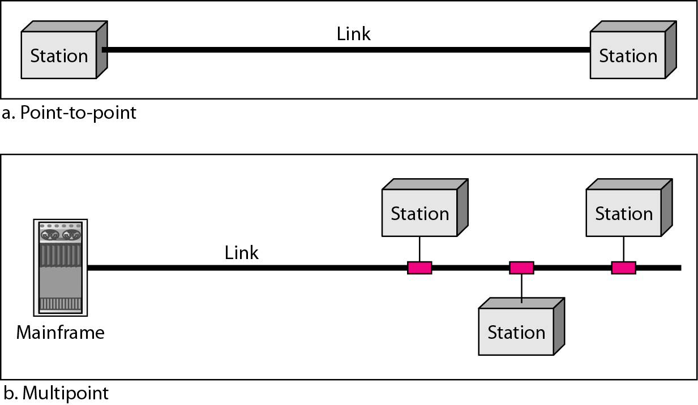
Figure 1.3 Types of connections: point-to-point and multipoint
A P2P connection provides a dedicated link between two devices.
The entire capacity of the link is reserved for transmission between those two devices.
Ex: When you change television channels by infrared remote control, you are establishing a P2P connection between the remote control and the television's control system.
A multipoint (also called multidrop) connection is one in which more than two specific devices share a single link.
In a multipoint environment, the capacity of the channel is shared, either spatially or temporally. If several devices can use the link simultaneously, it is a spatially shared connection. If users must take turns, it is a timeshared connection.

Slide 12
Network Topology
The term network topology refers to the way in which a network is laid out physically.
The topology of a network is the geometrical representation of the relationship of all the links and linking devices (usually called nodes) to one another.
There are 4 basic topologies possible --

Slide 13
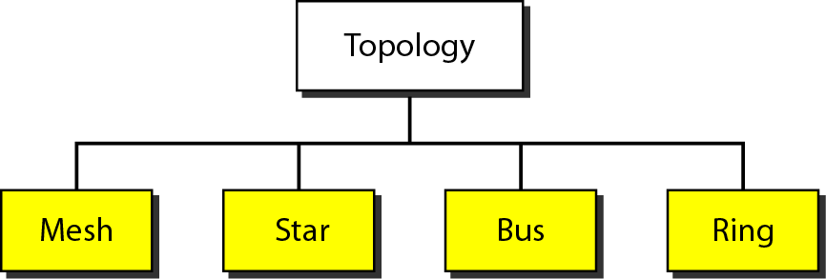
Figure 1.4 Categories of topology

Slide 14
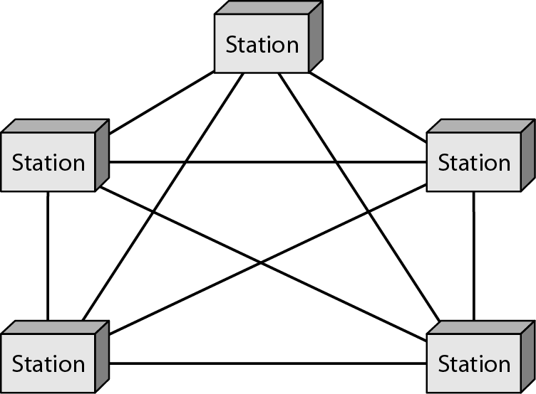
Figure 1.5 A fully connected mesh topology (five devices)

Slide 15
In this topology, every device has a dedicated point-to-point link to every other device.
The term dedicated means that the link carries traffic only between the two devices it connects.
To find the number of physical links in a fully connected mesh network with ‘n’ nodes, Node 1 must be connected to every other (n-1) nodes, likewise Node 2 must be connected to every other (n-1) nodes … and finally Node N must be connected to every other (n-1) nodes. Hence, total number of physical links will be n(n-1).
If each physical link allows communication in both directions (duplex mode), we can divide the number of links by 2, i.e., in mesh topology, we need n(n-1)/2 duplex mode links.
To accommodate these many links, every device on network must have n-1 I/O ports to be connected to the other n-1 stations.

Slide 16
Advantages of Mesh Topology
-- the use of dedicated links guarantees that each connection can carry its own data load, thus eliminates traffic problems.
-- mesh links are robust, because, if one link becomes unusable (broken), it does not incapacitate the entire system.
-- privacy/security, because, when every message travels along a dedicated link, only the intended recipients receives it.
Disadvantages of Mesh Topology
-- amount of cabling and number of I/O ports required is very high.
-- installation and reconnections are difficult.
-- hardware requirements are very high.
* One practical example of a mesh topology is the connection of telephone regional offices in which each regional office needs to be connected to every other regional office

Slide 17
Assume six devices are arranged in a mesh topology. How many cables are needed? How many ports are needed for each device?

Slide 18
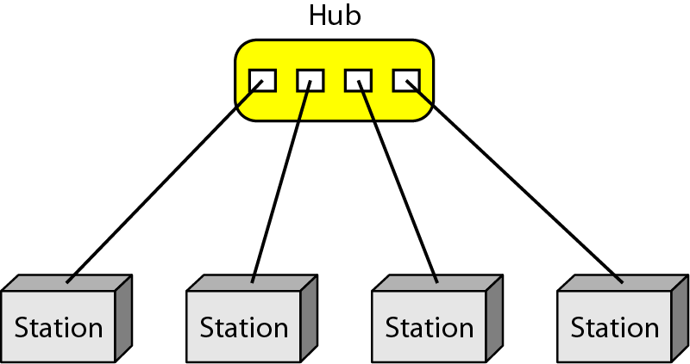
Figure 1.6 A star topology connecting four stations

Slide 19
Each device has a dedicated point-to-point link only to a central controller, usually called a hub.
The devices are not directly linked to one another. Unlike a mesh topology, a star topology does not allow direct traffic between devices.
The controller acts as an exchange: If one device wants to send data to another, it sends the data to the controller, which then relays the data to the other connected device.
Advantages of Star topology
A star topology is less expensive than a mesh topology. In a star, each device needs only one link and one I/O port to connect it to any number of others.
This factor also makes it easy to install and reconfigure. Far less cabling needs to be housed.
Other advantages include robustness. If one link fails, only that link is affected. All other links remain active. This factor leads to easy fault identification and fault isolation.

Slide 20
Disadvantages of Star topology
One big disadvantage of a star topology is the dependency of the whole topology on one single point, the hub. If the hub goes down, the whole system is dead.
* The star topology is used in local-area networks (LANs). High-speed LANs often use a star topology with a central hub.

Slide 21
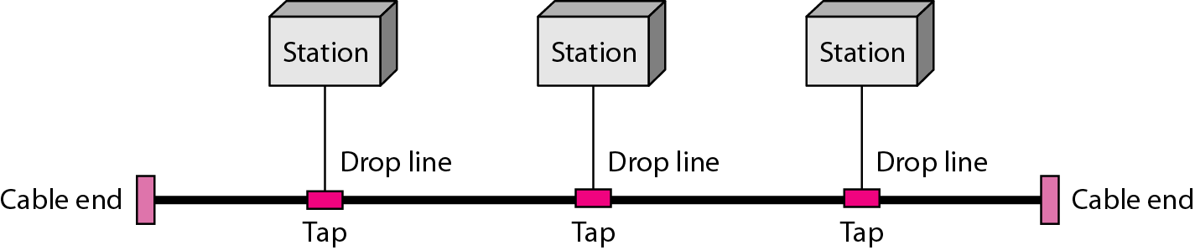
Figure 1.7 A bus topology connecting three stations

Slide 22
A bus topology is based on multipoint connections. One long cable acts as a backbone to link all the devices in a network.
Nodes are connected to the bus cable by drop lines and taps.
A drop line is a connection between the device and the main cable.
A tap is a connector that either splices into the main cable or punctures the sheathing of a cable to create a contact with the metallic core.
As a signal travels along the backbone, some of its energy is transformed into heat. Therefore, it becomes weaker and weaker as it travels farther and farther.
For this reason there is a limit on the number of taps a bus can support and on the distance between those taps.

Slide 23
Advantages of Bus Topology
Ease of installation.
A bus uses less cabling than mesh or star topologies.
Disadvantages of Bus Topology
difficult reconnection and fault isolation.
difficulty in adding new devices in the system.
signal reflection at the taps can cause degradation in quality.
this degradation can be controlled by limiting the number and spacing of devices connected to a given length of cable.
adding new devices may therefore require modification or replacement of the backbone.
a fault or break in the bus cable stops all transmission, even between devices on the same side of the problem. The damaged area reflects signals back in the direction of origin, creating noise in both directions.

Slide 24
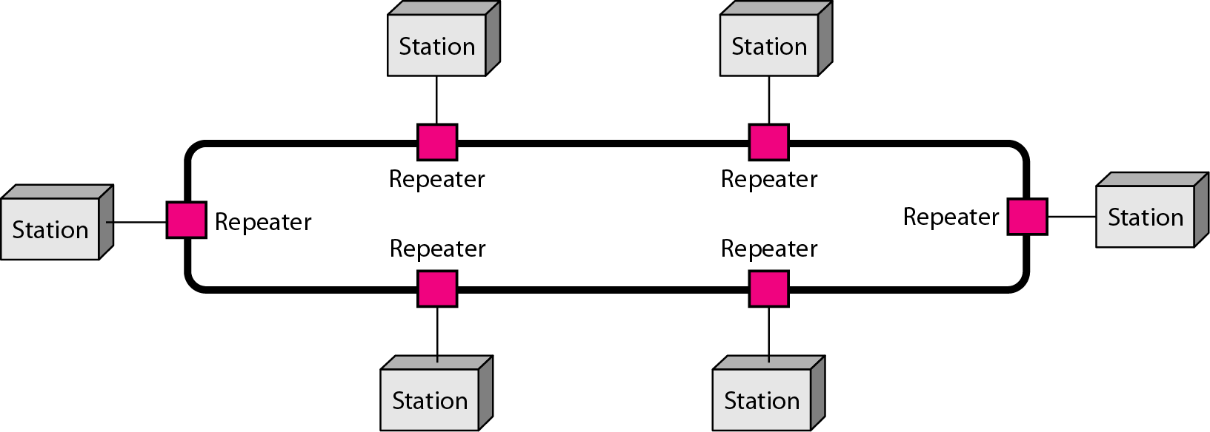
Figure 1.8 A ring topology connecting six stations

Slide 25
In a ring topology, each device has a dedicated point-to-point connection with only the two devices on either side of it.
A signal is passed along the ring in one direction, from device to device, until it reaches its destination.
Each device in the ring incorporates a repeater. When a device receives a signal intended for another device, its repeater regenerates the bits and passes them along.

Slide 26
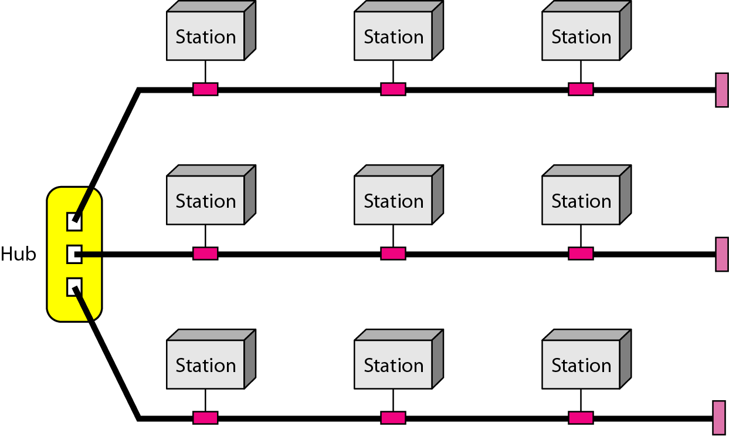
Figure 1.9 A hybrid topology: a star backbone with three bus networks

Slide 27
Categories of Networks
Local Area Networks (LANs)
Short distances
Designed to provide local interconnectivity
Wide Area Networks (WANs)
Long distances
Provide connectivity over large areas
Metropolitan Area Networks (MANs)
Provide connectivity over areas such as a city, a campus

Slide 28
LANs
A LAN is usually privately owned networks and links the devices in a single office, building, or campus.
A LAN can be as simple as two PCs and a printer in someone's home office or it can extend throughout a company and include audio and video peripherals.
Currently, LAN size is limited to a few kilometers.
The most common LAN topologies are bus, ring, and star.
Early LANs had data rates in the 4 to 16 megabits per second (Mbps) range. Today, however, speeds are normally 100 or 1000 Mbps.

Slide 29
WANs
A WAN provides long-distance transmission of data, image, audio, and video information over large geographic areas that may comprise a country, a continent, or even the whole world.
MANs
A metropolitan area network (MAN) is a network with a size between a LAN and a WAN. It normally covers the area inside a town or a city.

Slide 30
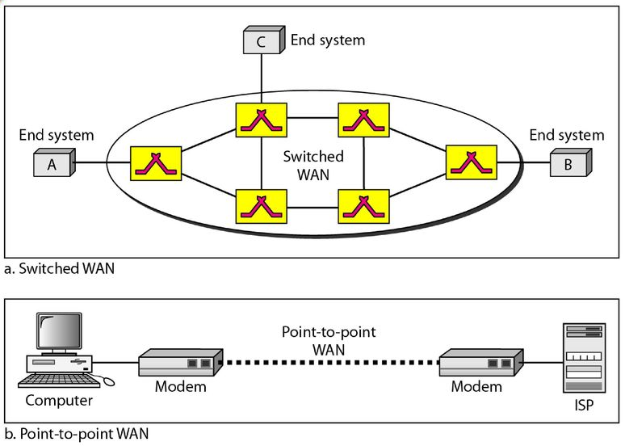
WAN can be classified into two broad categories: switched WAN and point-to-point WAN.
-- The switched WAN connects the end systems, which usually comprise a router (internetworking
connecting device) that connects to another LAN or WAN.
-- The point-to-point WAN is normally a line leased from a telephone or cable TV provider that connects a home computer or a small LAN to an Internet service provider (lSP).
WANs: a switched WAN and a point-to-point WAN

Slide 31
Interconnection of Networks: Internetwork
The LANs, MANs, and WANs rarely works in isolation, practically, they are connected to one another.
When two or more such networks are connected, they become an internetwork, or internet.

Slide 32
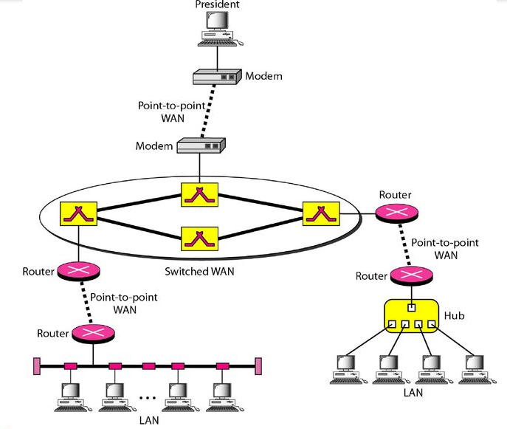
To create a backbone WAN for connecting these three entities (two LANs and the president's computer),
A switched WAN (operated by a service provider such as a telecom company) has been leased.
To connect the LANs to this switched WAN, three point-to-point WANs are required.
These point-to-point WANs can be a high-speed DSL line offered by a telephone company or a cable modem line offered by a cable TV provider.
West Side
East Side
A heterogeneous network made of four WANs and two LANs

Slide 33
1-4 PROTOCOLS
A protocol is synonymous with rule. It consists of a set of rules that govern data communications. It determines what is communicated, how it is communicated and when it is communicated. The key elements of a protocol are syntax, semantics and timing
Topics discussed in this section:
Syntax
Semantics
Timing

Slide 34
Elements of a Protocol
Syntax
Structure or format of the data
Indicates how to read the bits - field delineation
Semantics
Interprets the meaning of the bits
Knows which fields define what action
Timing
When data should be sent and what
Speed at which data should be sent or speed at which it is being received.

Slide 35
Name the four basic network topologies, and cite an advantage of each type.
What is the difference between half-duplex and full-duplex transmission modes?
For n devices in a network, what is the number of cable links required for a mesh, bus, and star topology?

Slide 36
For each of the following four networks, discuss the consequences if a connection fails.
Five devices arranged in a mesh topology.
If one connection fails, the other connections will still be working
Five devices arranged in a star topology (not counting the hub).
The other devices will still be able to send data through the hub; there will be no access to the device which has the failed connection to the hub.
Five devices arranged in a bus topology.
All transmission stops if the failure is in the bus. If the drop-line fails, only the corresponding device cannot operate.

